Slide 1
SMART HEALTH APPOINTMENT
DEPARTMENT OF COMPUTER SCIENCE AND ENGINEERING
SKILL ENHANCEMENT PROJECT
PROJECT STUDENT
U. Sai Manikanta Praveen, 43111292

Slide 2
AGENDA
Abstract
Existing system
Proposed system
Advantages
Disadvantages
Hardware requirements
Software requirements
Modules
Module description
Sample output(screenshot)
Conclusion

Slide 3
ABSTRACT
The Smart Health Appointment System is a web-based application designed to streamline the process of scheduling medical appointments between patients and doctors. the system ensures efficient management of healthcare appointments. It allows patients to easily register, search for doctors based on specialization, and book, reschedule, or cancel appointments conveniently. Doctors can manage their availability, view upcoming appointments, and interact with patients through a user-friendly dashboard.

Slide 4
EXISTING SYSTEM
Most existing models are commercial and region-specific, limiting accessibility for small hospitals or educational use.
Traditional Hospital Management Systems (HMS) often include appointment features but lack modern web technologies and flexibility.
They depend on centralized databases and outdated interfaces, making them harder to scale or customize.
The Systems are Region-specific or subscription-based and Mostly proprietary

Slide 5
PROPOSED SYSTEM
The system provides role-based access for three main users Patients, Doctors, and Administrators each with distinct functionalities to ensure secure and efficient operation.
Doctors can manage their profiles, define available slots, and view upcoming or completed appointments.
It aims to reduce administrative workload, eliminate manual scheduling errors, and improve patient satisfaction through digital automation and transparency.
Provides real-time slot availability, automated reminders, and easy appointment rescheduling or cancellation.

Slide 6
ADVANTAGES
.
Patients can easily book, reschedule, or cancel appointments
Doctors’ availability and appointment slots are updated instantly, ensuring no double-booking.
Reduces the need for manual registers or paperwork, improving efficiency in hospitals and clinics.
The admin can view reports and appointment statistics to analyze system usage and performance.

Slide 7
DISADVANTAGES
Requires a stable internet connection for accessing and booking appointments.
Sensitive patient data must be handled carefully to comply with privacy standards.
Cannot be used effectively when there is no network connectivity.
Admins and doctors may need brief training to understand and operate the system efficiently.

Slide 8
HARDWARE REQUIREMENTS
Minimum: Intel Core i3 processor, 4 GB RAM, 1280x720 screen resolution
Recommended: Intel Core i5 or better, 8 GB RAM, Full HD (1920x1080) display
Input: Keyboard and mouse or touchpad
Compatible with desktop PC, laptop, tablet, or smartphone
Internet connection required for initial load

Slide 9
SOFTWARE REQUIREMENTS
Operating System: Windows 10 or later, macOS 10.14 or later, Linux (Ubuntu 20.04+), or modern OS
Java for building backend logic and APIs.
Spring Boot 3.x for developing RESTful web services MongoDB 6.0 for flexible and scalable data storage.
HTML5, CSS3, JavaScript for design and layout.
tools for development: VS Code, Sublime Text, Atom, Node.js and npm

Slide 10
MODULES
Authentication
Home page
Appointment Scheduling
Patient Management
Doctor Management

Slide 11
MODULE DESCRIPTIONS
Authentication: Allows secure admin access with login, and logout features.
Home Page: shows all available patients doctors and Appointments
Appointment Scheduling : Core module that manages slot booking, time validation
Admin Management : Admins can monitor all activities, including users, doctors, and appointments.

Slide 12
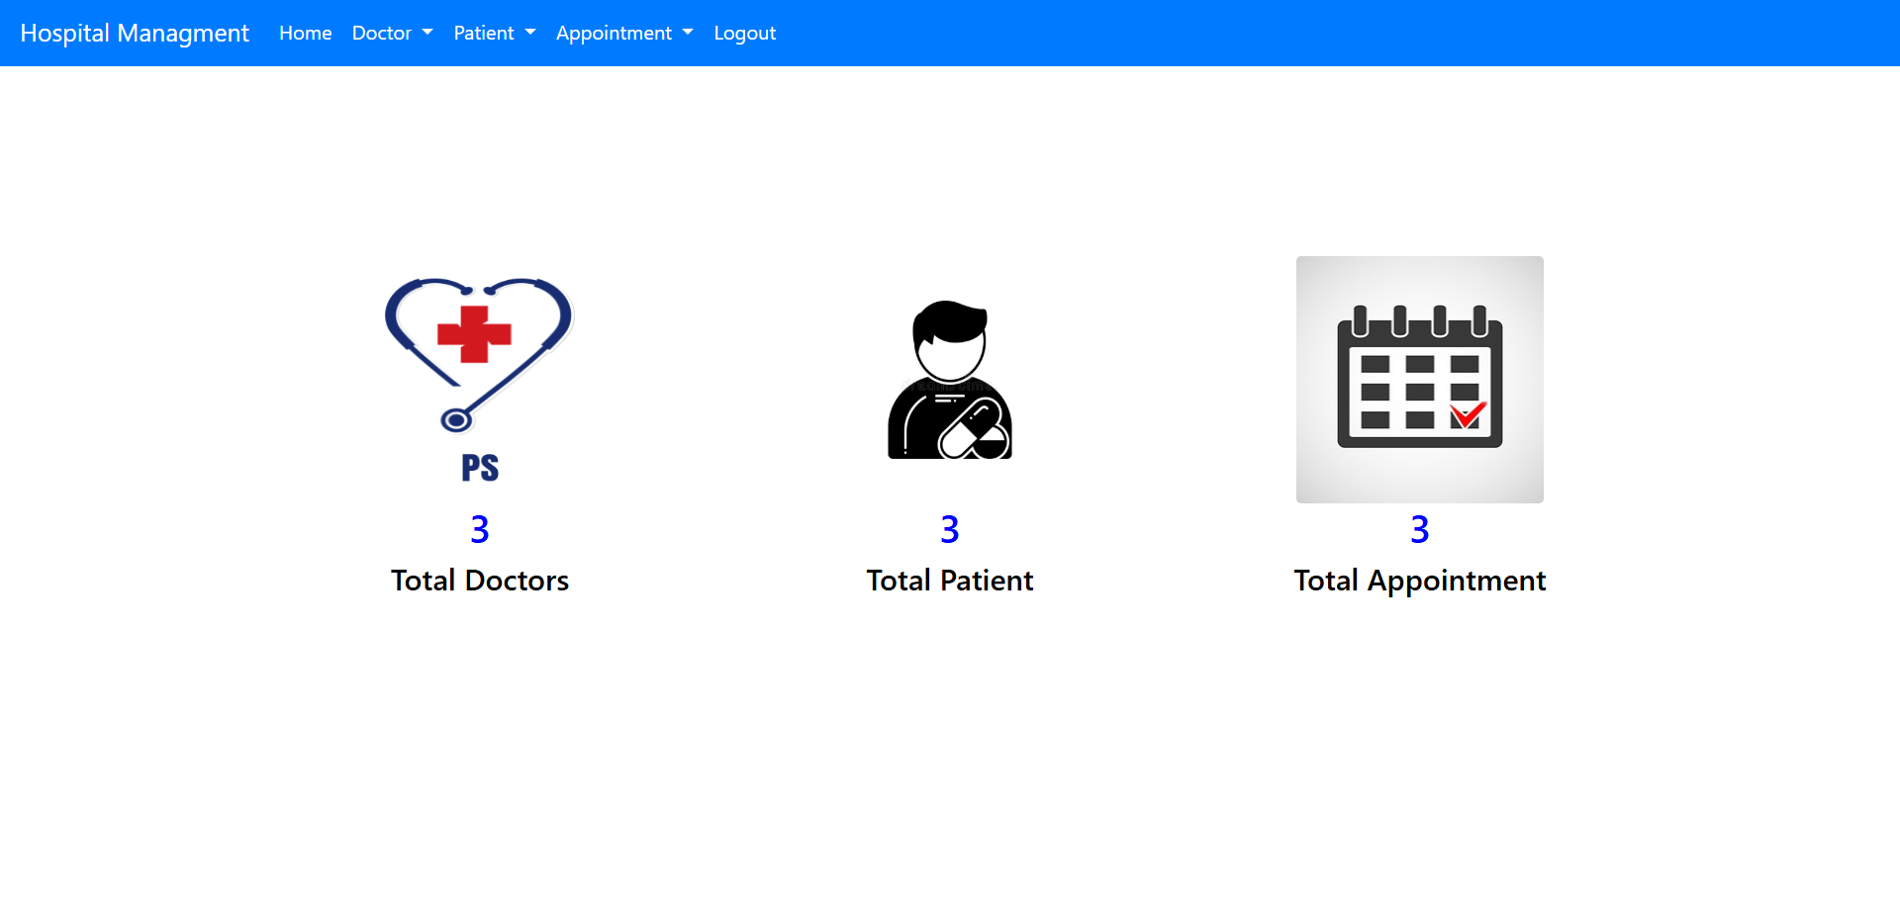
SAMPLE OUTPUT
Fig1:-HOME PAGE

Slide 13
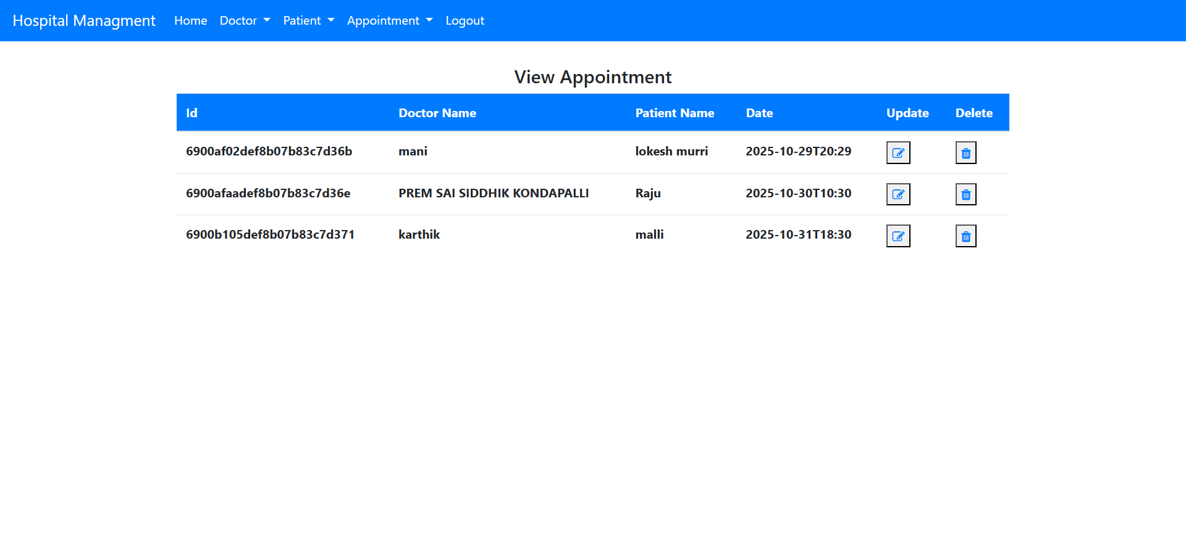
APPOINTMENT PAGE

Slide 14
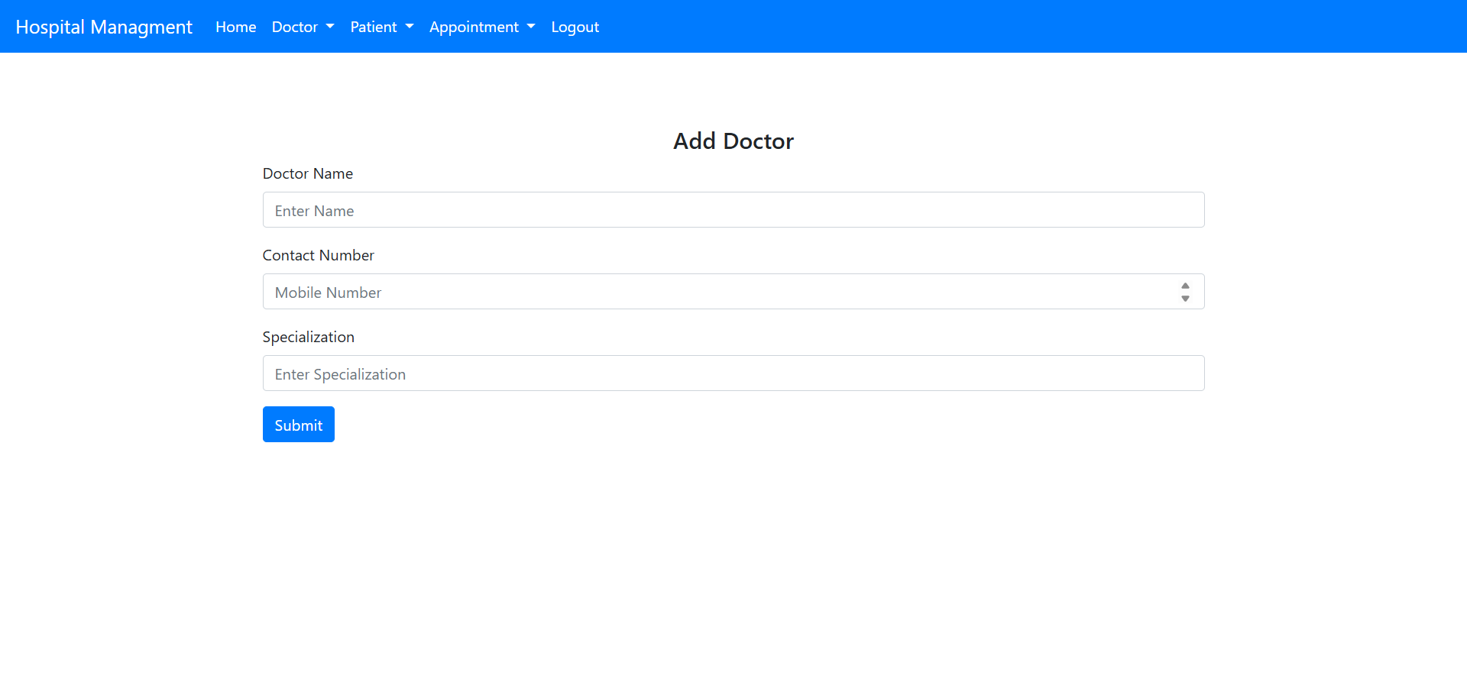
DOCTOR MANAGEMENT

Slide 15
CONCLUSION
The Smart Health Appointment System is a web-based platform that simplifies the process of booking and managing doctor appointments. It enhances communication between patients and doctors while reducing manual scheduling work the system ensures security, scalability, and real-time performance. It provides an efficient way to manage healthcare services digitally. Overall, this project helps improve accessibility, save time, and make healthcare management smarter and more convenient.

